Slide 1




x
CMake
Introduction to CMake and the Third-party C++ Dependency Manager
Jeff Ho
CENTRILLION
TECHNOLOGIES

Slide 2

Introduction to Modern CMake
CMake

Slide 3
Introduction
CMake is code.
CMake is a meta build system (build system generator).
Configuration Stage
Parse the CMakeLists.txt
Create a CMakeCache.txt file populated with cache variables.
Generation Stage
Generates project files or build system files (e.g. Makefile) according to the specified building system (e.g. Make, Xcode, MSBuild, Visual Studio, etc).
Building Stage
Targets are compiled (e.g. executables, libraries, etc.).
Actions associated with each targets are executed.
Written in C++, cross-platform.
Used by many projects.
CMake GUI & CMake command line.

Slide 4
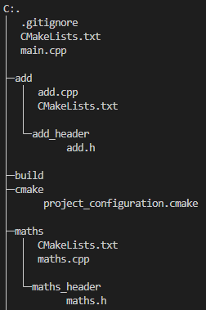
Organization and workflow
Entry point: The top-level CMakeLists.txt
Out-of-source build – the source directory is different from the binary directory.
Source directory: Directory where the project’s CMakeLists.txt resides.
Binary directory: Directory where the project files are generated (& CMakeCache.txt resides).
CMake commands
Generate project files or build system files (configuration stage & generation stage are combined in the command-line mode.) [-G "Generator Support”]
cmake ..
Build (Compile) the project (building stage).
cmake --build .. (or make)
Run unit-tests
ctest .. (or make test)
Build project and install package
cmake --build .. --target install (or make install)
Packaging project
cpack ..
Command line options
-DCMAKE_BUILD_TYPE:STRING=Release or -DCMAKE_BUILD_TYPE=“Release”

Slide 5
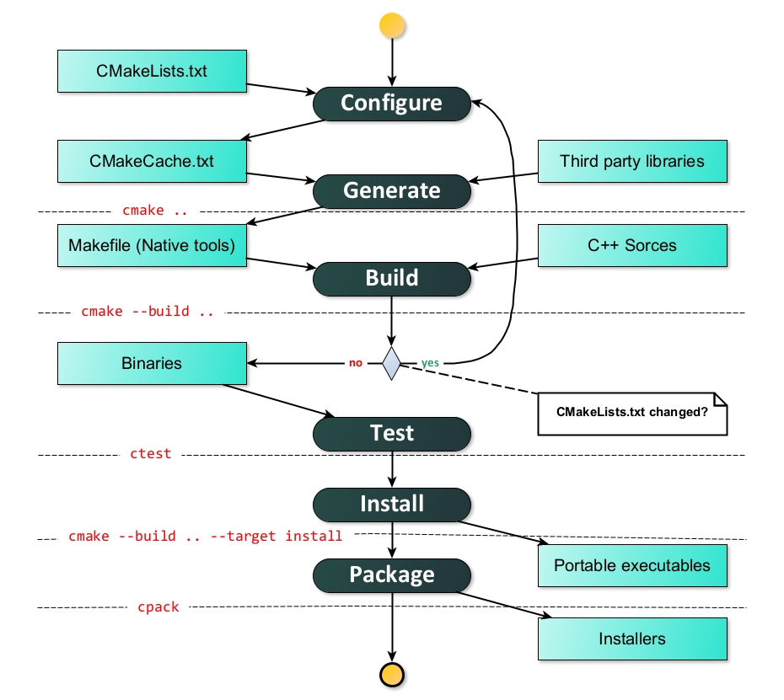
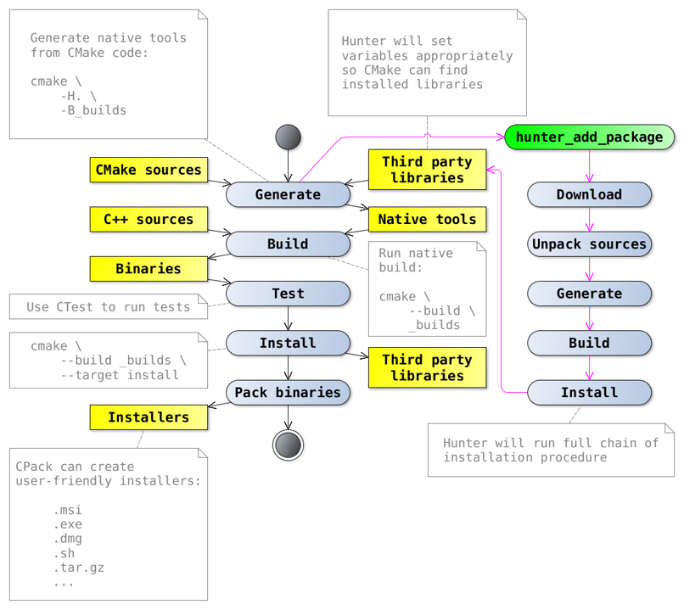
Organization and workflow

Slide 6
CMake Language
Data type
String
List (of strings)
Control Structures (if, foreach, while)
Functions
Built-in (implemented inside CMake)
User-defined
Macros
Modules

Slide 7
From Configuration to Building Stage
Build the executables.

Slide 8
Building Procedure Management
Flow control in CMake
set(var1 OFF)
set(var2 ON)
if(var1)
message(STATUS "var1 is evaluated to false.")
elseif(var2)
message(STATUS "var2 is evaluated to true.")
else()
message(STATUS "The program will not enter this area.")
endif()

Slide 9
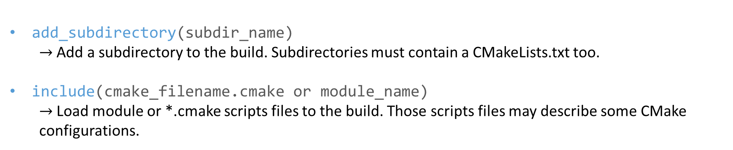
Building Procedure Management
add_subdirectory(subdir_name)
$→$ Add a subdirectory to the build. Subdirectories must contain a CMakeLists.txt too.
include(cmake_filename.cmake or module_name)
$→$ Load module or *.cmake scripts files to the build. Those scripts files may describe some CMake configurations.

Slide 10
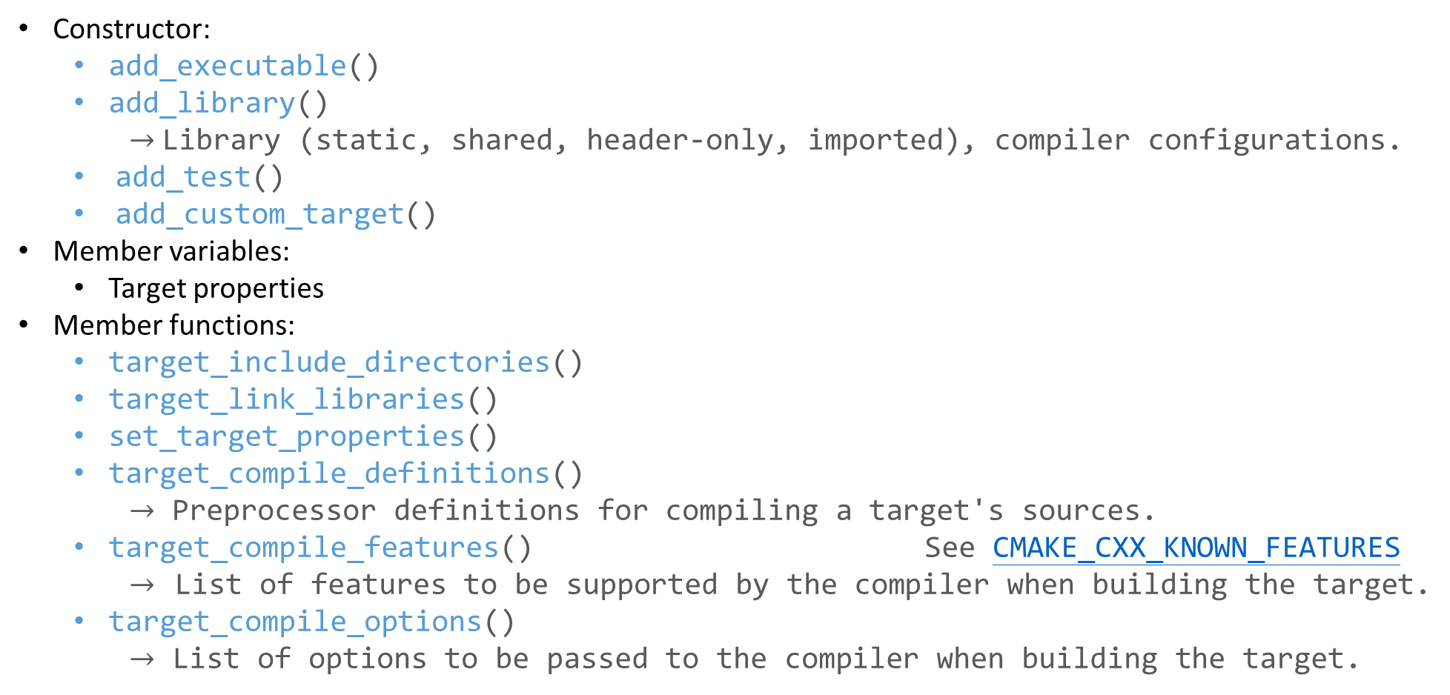
Targets as Objects
Constructor:
add_executable()
add_library()
$→$ Library (static, shared, header-only, imported), compiler configurations.
add_test()
add_custom_target()
Member variables:
Target properties
Member functions:
target_include_directories()
target_link_libraries()
set_target_properties()
target_compile_definitions()
$→$ Preprocessor definitions for compiling a target's sources.
target_compile_features() See CMAKE_CXX_KNOWN_FEATURES
$→$ List of features to be supported by the compiler when building the target.
target_compile_options()
$→$ List of options to be passed to the compiler when building the target.

Slide 11
Build Specification and Usage Requirements
add_executable(example main.cpp)
target_link_libraries(example
PUBLIC
spdlog::spdlog
PRIVATE
maths_library)
PUBLIC, PEIVATE, and INTERFACE
PRIVATE populates the non-INTERFACE_XXXX property only.
INTERFACE populates the INTERFACE_XXXX property only.
PUBLIC populates both.
Building and consuming the target
Non-INTERFACE_XXXX properties define the build specification of a target.
– XXXX property is used only when building the target and won’t affect its users in any way.
INTERFACE_XXXX properties define the usage requirements of a target (for downstream applications).
– XXXX property is used when building users of the target.
maths_library: LINK_LIBRARIES.
spdlog::spdlog: LINK_LIBRARIES and INTERFACE_LINK_LIBRARIES.

Slide 12
Build Specification and Usage Requirements
Header-only libraries
add_library(example INTERFACE)
target_link_libraries(example INTERFACE spdlog::spdlog)
INTERFACE libraries (header-only libraries) have no build specification.
They only have usage requirements (nothing to build).

Slide 13
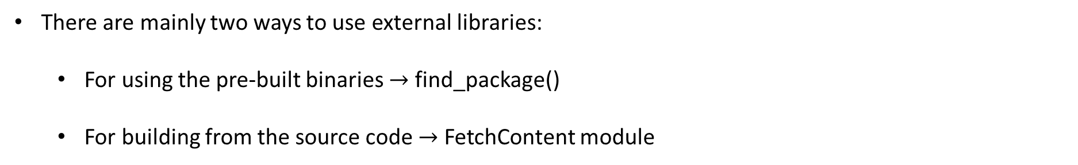
Using External Libraries
There are mainly two ways to use external libraries:
For using the pre-built binaries $→$ find_package()
For building from the source code $→$ FetchContent module

Slide 14
Using External Libraries
find_package(GTest 1.10 CONFIG REQUIRED)
add_executable(example example.cpp)
target_link_libraries(
example
INTERFACE
GTest::gtest
GTest::gtest_main
)
Find the specified package installed on the local system and loads exported targets.
REQUIRED is added to specify some package is necessary for the configure stage of the project.
Two distinct ways for searching the libraries:
Module mode (default)
search Find<PackageName>.cmake
Config mode
search <lowercasePackageName>-config.cmake or <PackageName>Config.cmake
Also search for <lowercasePackageName>-config-version.cmake or <PackageName>ConfigVersion.cmake if version details were specified.
(Optional) CMAKE_PREFIX_PATH may be set to find the prebuilt binaries.

Slide 15
Using External Libraries
include(FetchContent) FetchContent_Declare(
googletest
GIT_REPOSITORY https://github.com/google/googletest.git
GIT_TAG release-1.10.0
) FetchContent_MakeAvailable(googletest)
# FetchContent_GetProperties(googletest)
# if (NOT googletest_POPULATED)
# FetchContent_Populate(googletest)
# endif ()
# add_subdirectory(${googletest_SOURCE_DIR} ${googletest_BINARY_DIR})
add_executable(example example.cpp)
target_link_libraries(
example
INTERFACE
gtest
gtest_main
)
FetchContent will build the source as a subproject.

Slide 16
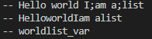
Variables
set(var_name "world")
set(list_var "I" "am a" "list")
set(Hello Hello)
set(world ${var_name} list_var)
message(STATUS "${Hello} ${var_name} ${list_var}")
message(STATUS ${Hello} ${var_name} ${list_var})
message(STATUS ${world})
Variables are set with the set( ) command.
Expand with ${ }.
Lists are separated by some specific delimiter (e.g. ; (semicolon))
Quotes are used in setting a variable when the value has a whitespace or semicolons.
Unset variable expands to empty string.
CMake built-in variables (e.g. CMAKE_XXXX, PROJECT_XXXX, <PROJECT-NAME>_XXXX, etc.)
More info: Here.

Slide 17

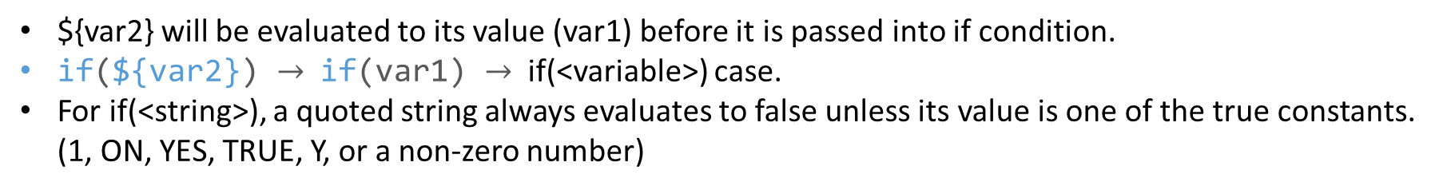
Variables
set(var1 OFF)
set(var2 "var1")
if(${var2})
message(STATUS "dollar var2")
endif() if("${var2}")
message(STATUS "quoted dollar var2")
endif() if(var2)
message(STATUS "clean var2")
endif() if("var2")
message(STATUS "quote var2")
endif()
${var2} will be evaluated to its value (var1) before it is passed into if condition.
if(${var2}) $→$ if(var1) $→$ if(<variable>) case.
For if(<string>), a quoted string always evaluates to false unless its value is one of the true constants. (1, ON, YES, TRUE, Y, or a non-zero number)

Slide 18
Generator Expression
set(run_time_exe_dir $<IF:$<PLATFORM_ID:Darwin>,@loader_path,$ORIGIN>)
Generator expressions use the $<> syntax.
Evaluated during the build system file generation (generation stage).
Some commands are not supported in the specific platform.
Generator expressions are often used to specify which mode we’re used (building the library or using it from an installed target).

Slide 19
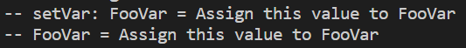
Function
function(setVar varName value)
set(${varName} ${value})
set(${varName} ${${varName}} PARENT_SCOPE)
message(STATUS "setVar: ${varName} = ${${varName}}")
endfunction()
setVar(FooVar "Assign this value to FooVar")
if(DEFINED FooVar)
message(STATUS "FooVar = ${FooVar}")
else()
message(STATUS "FooVar is undefined")
endif()
Like in C/C++, functions introduce a new scope.
Variables are scoped to the function, unless set with the PARENT_SCOPE argument.
When a new command replaces an existing command, the old one can be accessed with a _ prefix.

Slide 20
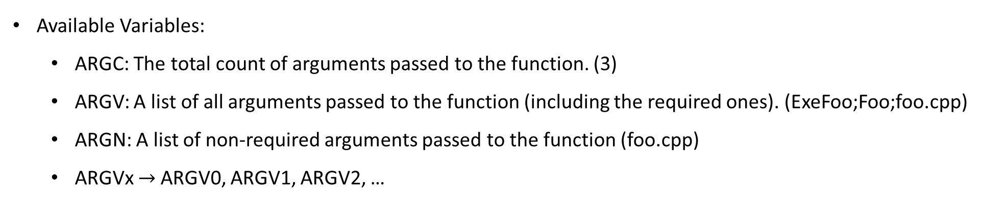
Function
function(AddExe targetName dependency)
add_executable(${targetName} ${ARGN})
target_link_libraries(${targetName} PRIVATE ${dependency})
endfunction()
AddExe(ExeFoo Foo foo.cpp)
Available Variables:
ARGC: The total count of arguments passed to the function. (3)
ARGV: A list of all arguments passed to the function (including the required ones). (ExeFoo;Foo;foo.cpp)
ARGN: A list of non-required arguments passed to the function (foo.cpp)
ARGVx $→$ARGV0, ARGV1, ARGV2, …

Slide 21
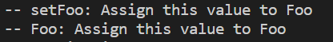
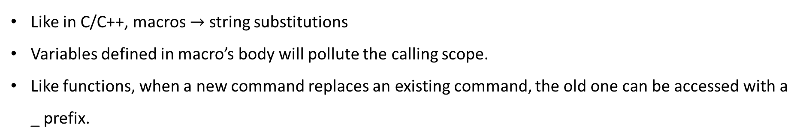
Macro
macro(setFoo value)
set(Foo ${value})
message(STATUS "setFoo: ${Foo}")
endmacro()
setFoo("Assign this value to Foo")
if(DEFINED Foo)
message(STATUS "Foo: ${Foo}")
else()
message(STATUS "Foo is undefined")
endif()
Like in C/C++, macros $→$ string substitutions
Variables defined in macro’s body will pollute the calling scope.
Like functions, when a new command replaces an existing command, the old one can be accessed with a _ prefix.

Slide 22
Testing Stage
Make sure all functions can be executed as expected.

Slide 23
Google Test
Add an executable target and register the target to Ctest through gtest_discover_tests() command.
Call the test in the building directory after building the testing target.
include(CTest)
add_executable(testexe basic_math.cpp) target_link_libraries(
testexe
PRIVATE
dependencies
gtest
gtest_main
)
include(GoogleTest) gtest_discover_tests(testexe)

Slide 24
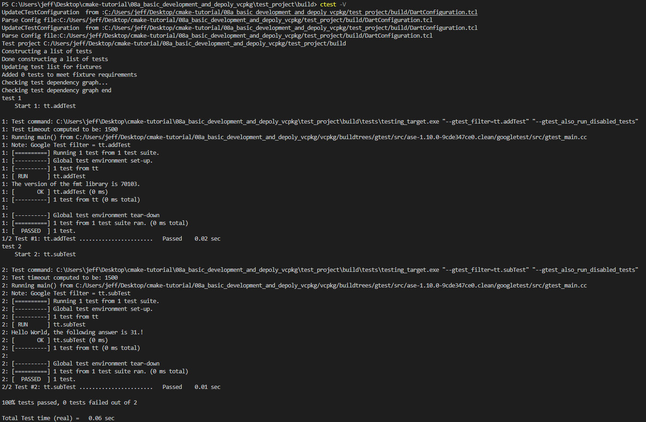

Slide 25
Catch2
Add an executable target and register the target to Ctest through catch_discover_tests() command.
Call the test in the building directory after building the testing target.
include(CTest)
add_executable(testexe basic_math.cpp) target_link_libraries(
testexe
PRIVATE
dependencies
Catch2WithMain
)
include(Catch) catch_discover_tests(testexe)

Slide 26
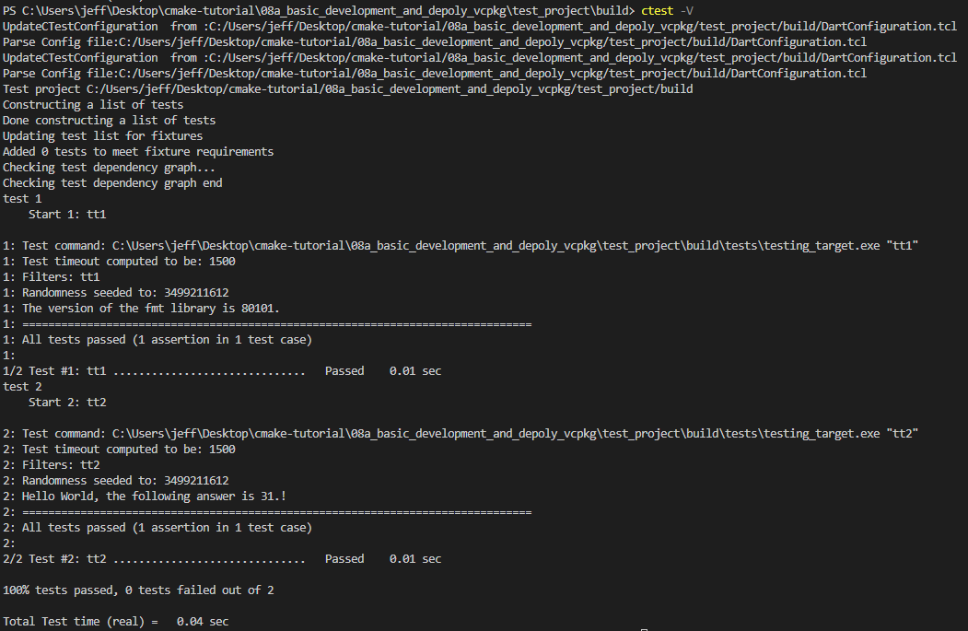

Slide 27
Installation Stage
Copy or generate files and configurations used for the downstream applications.

Slide 28
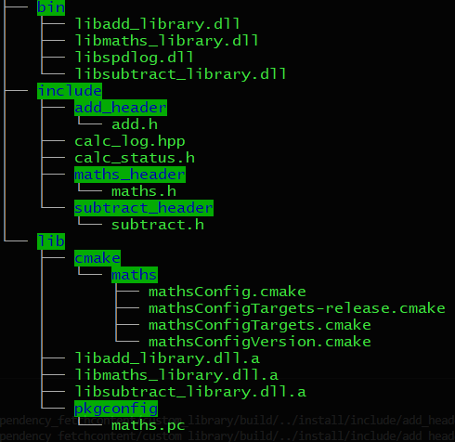
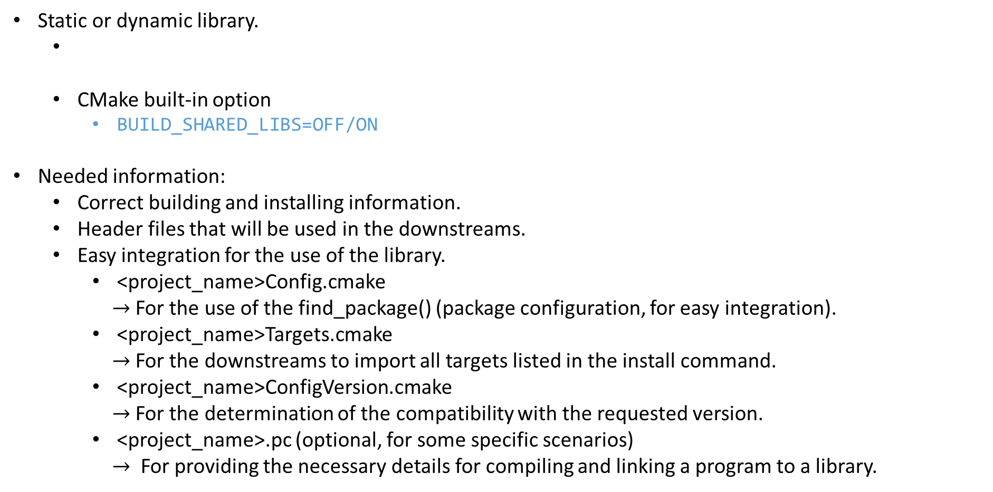
Export Our Library
Static or dynamic library.
CMake built-in option
BUILD_SHARED_LIBS=OFF/ON
Needed information:
Correct building and installing information.
Header files that will be used in the downstreams.
Easy integration for the use of the library.
<project_name>Config.cmake
$→$ For the use of the find_package() (package configuration, for easy integration).
<project_name>Targets.cmake
$→$ For the downstreams to import all targets listed in the install command.
<project_name>ConfigVersion.cmake
$→$ For the determination of the compatibility with the requested version.
<project_name>.pc (optional, for some specific scenarios)
$→$ For providing the necessary details for compiling and linking a program to a library.
add_library(static_library_name STATIC sources1.cpp)
add_library(shared_library_name SHARED sources2.cpp)

Slide 29
Export Our Library
Correct building and installing information.
Provide the flexibility to install into different platform layouts.
Use generator expressions to differentiate which mode we’re used (building the library or using it from an installed target).
Project installation destination – set the CMAKE_INSTALL_PREFIX variable.
Header files that will be used in the downstreams.
include(GNUInstallDirs)
target_include_directories(
library_name
PUBLIC
$<BUILD_INTERFACE:${CMAKE_CURRENT_SOURCE_DIR}>
$<INSTALL_INTERFACE:${CMAKE_INSTALL_INCLUDEDIR}>
)
install(
FILES ${CMAKE_CURRENT_SOURCE_DIR}/header_name.hpp
DESTINATION ${CMAKE_INSTALL_INCLUDEDIR}
)

Slide 30
Export Our Library
Easy integration for the use of the library
Specify the target, the export target name and the destinations that tell CMake where to install the targets (the following variables are provided by GNUInstallDirs module).
Install the export targets to export all targets in “library_projectTargets” (contains usage requirements, e.g. INTERFACE_XXXXX) to a file.
install(
TARGETS module_or_library
EXPORT library_projectTargets
LIBRARY DESTINATION ${CMAKE_INSTALL_LIBDIR}
ARCHIVE DESTINATION ${CMAKE_INSTALL_LIBDIR}
RUNTIME DESTINATION ${CMAKE_INSTALL_BINDIR}
)
install(
EXPORT library_projectTargets
NAMESPACE library_project::
FILE library_projectTargets.cmake
DESTINATION ${export_dest_dir}
)

Slide 31
Export Our Library
Easy integration for the use of the library
Create a package version file to determine the compatibility with the requested version (e.g. semver concept).
Create the package configuration template file (*Config.cmake.in) and specified all required dependencies of this library in that file.
include(CMakePackageConfigHelpers)
write_basic_package_version_file(
library_projectConfigVersion.cmake
VERSION ${PROJECT_VERSION}
COMPATIBILITY SameMajorVersion
)
@PACKAGE_INIT@
include(CMakeFindDependencyMacro)
find_dependency(dependencies REQUIRED) include(${CMAKE_CURRENT_LIST_DIR}/library_projectTargets.cmake)
set_and_check(library_project_INCLUDE_DIR "@PACKAGE_CMAKE_INSTALL_INCLUDEDIR@")
check_required_components(library_project)

Slide 32
Export Our Library
Easy integration for the use of the library
Create the package configuration file through the template file and the configure_package_config_file() command (ensuring the resulting package is relocatable).
Create the pkg-config file through the template file (*.pc.in) and the configure_file() command
include(CMakePackageConfigHelpers)
configure_package_config_file(
library_projectConfig.cmake.in
library_projectConfig.cmake
PATH_VARS CMAKE_INSTALL_INCLUDEDIR
INSTALL_DESTINATION ${export_dest_dir}
)
configure_file(“${PROJECT_NAME}.pc.in”
"${CMAKE_BINARY_DIR}/${PROJECT_NAME}.pc" @ONLY)

Slide 33
Export Our Library
Easy integration for the use of the library
The template file (*.pc.in) for creating the pkg-config file (*.pc).
prefix=@CMAKE_INSTALL_PREFIX@
exec_prefix=${prefix}
includedir=${prefix}/include
libdir=${exec_prefix}/@CMAKE_INSTALL_LIBDIR@
Name: lib@PROJECT_NAME@
Description: A CMake library template.
URL: http://gitlab.centrilliontech.com.tw:10088/centrillion/@PROJECT_NAME@
Version: @PROJECT_VERSION@
CFlags: -I${includedir} @PKG_CONFIG_DEFINES@
Libs: -L${libdir} -l@PROJECT_NAME@
Requires: @PKG_CONFIG_REQUIRES@

Slide 34
Export the Application Executables
Static dependencies.
The executables of applications should be executed without any further dependencies' installation.
Dynamic dependencies.
Application executables find dependencies through a built-in manner (depending on the OS).
Use the fixup_bundle() command to analyze the dependencies binaries or directly copy all binaries of the dependencies into specified directory (depending on the OS).
WINDOWS: Next to the application executables.
UNIX: lib folder in the portable package.
Set the RPATH of the application executables (UNIX only)
Run time executables directory symbol
MacOS: @loader_path
UNIX: $ORIGIN

Slide 35
Export the Application Executables
Dependencies searching order.
UNIX
The executable’s rpath.
The LD_LIBRARY_PATH environment variable.
The executable’s runpath.
The /etc/ld.so.conf file.
Default system libraries (/lib and /usr/lib)
Windows
The executable’s directory.
The system directory (default: C:/Windows/System32)
The 16-bit system directory.
The Windows directory (default: C:/Windows).
The current working directory.
The directories that are added and listed in the PATH environment variable.

Slide 36
Troubleshooting Information
Logging: message(STATUS “var=${var}”)
Check CMakeCache.txt file
Check the output generated files
Add if() to judge specified conditions
Check the compile_commands.json file after adding -DCMAKE_EXPORT_COMPILE_COMMANDS=TRUE option
Add the -DCMAKE_VERBOSE_MAKEFILE=TRUE option when configuring the project to see the detailed gcc/g++ compiling information.

Slide 37
That’s it!
Remember these and you know the guts of Modern CMake.

Slide 38
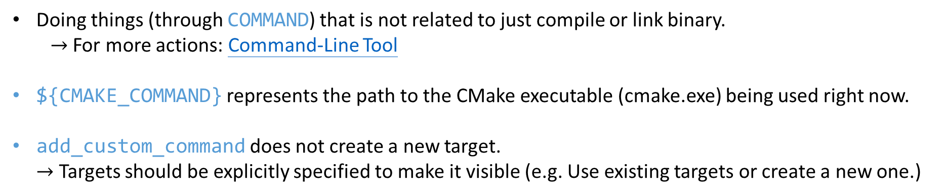
Special Commands – Custom Targets
add_executable(exmaple_exe example.cpp)
add_custom_command(
TARGET exmaple_exe
POST_BUILD
COMMAND
${CMAKE_COMMAND} -E touch ${CMAKE_CURRENT_BINARY_DIR}/generated_file1.txt
COMMENT
"Create the generated_file1.txt after all other rules within the target have been executed (i.e. after building the example_exe target)."
)
Doing things (through COMMAND) that is not related to just compile or link binary.
$→$ For more actions: Command-Line Tool
${CMAKE_COMMAND} represents the path to the CMake executable (cmake.exe) being used right now.
add_custom_command does not create a new target.
$→$ Targets should be explicitly specified to make it visible (e.g. Use existing targets or create a new one.)

Slide 39
Special Commands – Custom Targets
add_custom_target(my_custom_target
DEPENDS
"${CMAKE_CURRENT_BINARY_DIR}/generated_file1.txt"
) add_custom_command(
OUTPUT
"${CMAKE_CURRENT_BINARY_DIR}/generated_file1.txt"
COMMAND
${CMAKE_COMMAND} -E touch ${CMAKE_CURRENT_BINARY_DIR}/generated_file1.txt
COMMENT
"Create the file each time the following DEPENDS is modified or the first time my_custom_target is built."
DEPENDS
${CMAKE_CURRENT_SOURCE_DIR}/source.cpp
)
Build the custom target through cmake --build . --target my_custom_target or add ALL argument to add_custom_target.

Slide 40
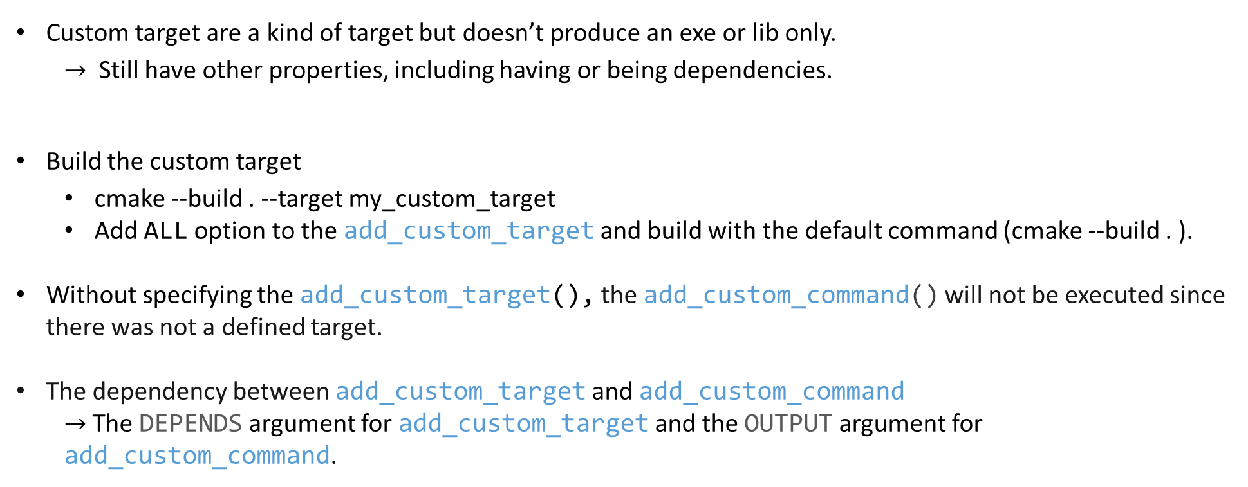
Special Commands – Custom Targets
Custom target are a kind of target but doesn’t produce an exe or lib only.
$→$ Still have other properties, including having or being dependencies.
Build the custom target
cmake --build . --target my_custom_target
Add ALL option to the add_custom_target and build with the default command (cmake --build . ).
Without specifying the add_custom_target(), the add_custom_command() will not be executed since there was not a defined target.
The dependency between add_custom_target and add_custom_command
$→$ The DEPENDS argument for add_custom_target and the OUTPUT argument for add_custom_command.

Slide 41
More …
Find module sample – CMake docs
find_package() – Find out all what is necessary to use some lib (find and load all settings).
find_program() – Find an executable file.
find_library() – Find the binaries of a library, shared or static.
find_file() – Find a file from the given full path.
find_path() – Find a directory that containing some specifically named file.
Creating Packages – CPack
Cross Compilation – toolchain.cmake

Slide 42


Third-party Dependency Manager
for C++
CMake

Slide 43
Introduction
Current Existing Package Managements
Git Submodule
Fetchcontent
Hunter
Conan
vcpkg (Microsoft)
Prerequisites for an ideal package manger
Cross-platform support.
Automatically install dependencies specified by the project and the upstream dependencies.
Manage the dependency versioning problems.
Easy integration with our build system (including and linking libraries).
Steady development and maintenance in the long term.
Healthy community of developers & users (for solving problems).
Internal library maintenance, distribution and version management.
(For library providers) Follow the exporting rule of CMake as much as possible.
Good Compatibility among different libraries.
Supports a wide range of packages.

Slide 44
How to get started
CMake-tutorial project: http://gitlab.centrilliontech.com.tw:10088/centrillion/cmake-tutorial
For Fetchcontent (build the library and application)
09a folder in the CMake-Tutorial.
For Microsoft – vcpkg (build the library and application)
08a folder (application, basic use for the manifest mode)
09b folder (library)
10 folder (library, patching mechanism for local fix)
For Conan (build the application case only)
08b folder (application, basic use)
For the library using the Conan framework, all the CMakeLists.txt files in the library should be substituted with the conanfile.txt written in Python and the CMake library provided by Conan.

Slide 45
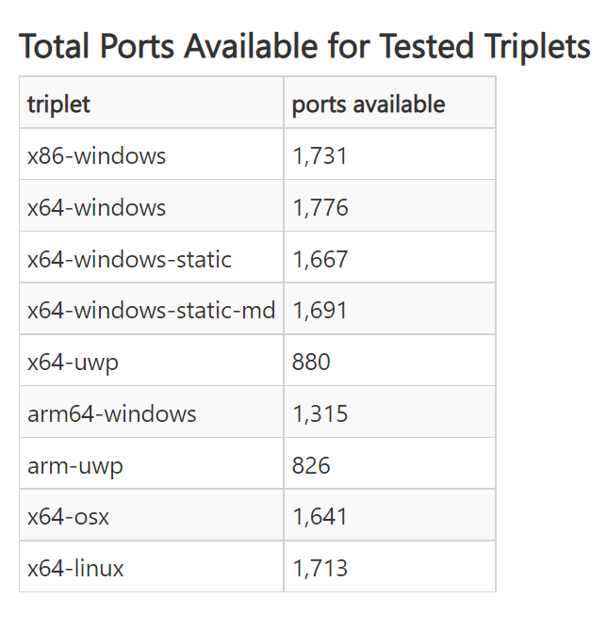
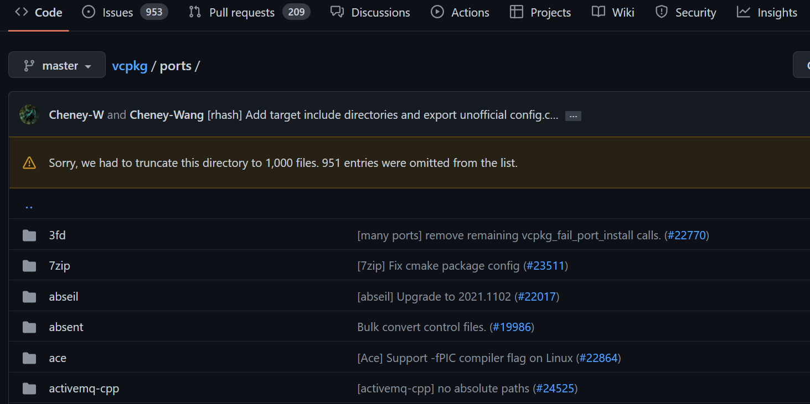
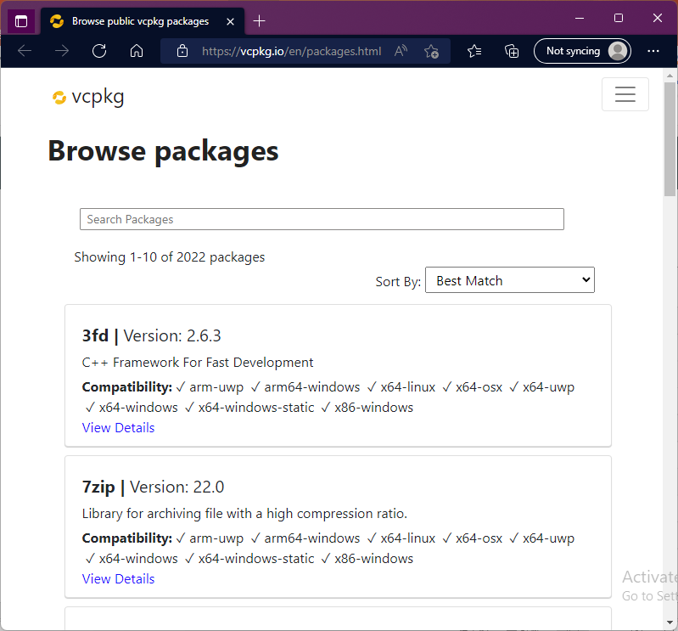
Officially Supported Library List
Port: A recipe for building a library.
Triplet describes the build configuration (target architecture, OS, etc.).
(2022)
https://vcpkg.io/en/packages.html
Officially Supported triplets

Slide 46
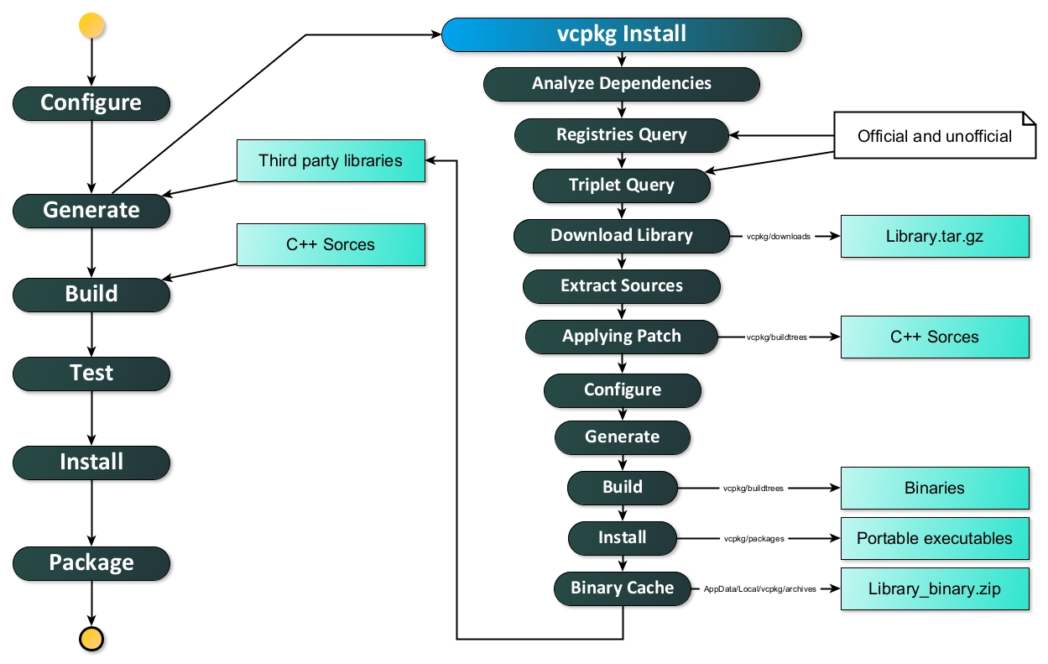
Overall Workflow for the vcpkg Dependency Manager

Slide 47
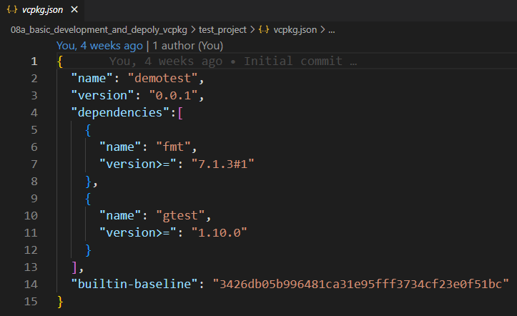
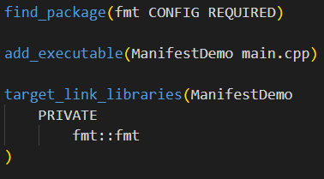
Manifest file: vcpkg.json
Goal: Allows developers to specify libraries, library metadata, library versions, and more.
Use the imported library in CMakeLists.txt.

Slide 48
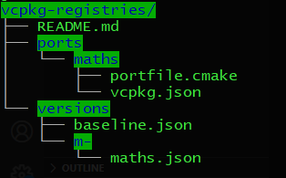
Manage Custom Libraries: Registries
portfile.cmake – (Library providers) A file that describes how to download, compile, and install the library.
vcpkg.json – (Library providers, downstream apps) A file that describes a project’s dependencies and their version info.
<port>.json – (Library providers) A file that lists all the versions available for a package and contain a Git tree-ish object that vcpkg can check out to obtain that version’s portfiles (in the ports folder).
baseline.json – (Library providers) This file contains a version declaration (a minimum version constraint) for each library in the vcpkg library repository (vcpkg-registries).
For any given revision of the registry (vcpkg-registries), the versions declared in the baseline file must match the current versions of the ports in the registry at that revision.
vcpkg-configuration.json – (downstream apps) A file that describes the download source of the vcpkg package repository (vcpkg-registries).
This file is needed when an unofficial dependency is used (to tell vcpkg where it can find and build this unofficial library).

Slide 49
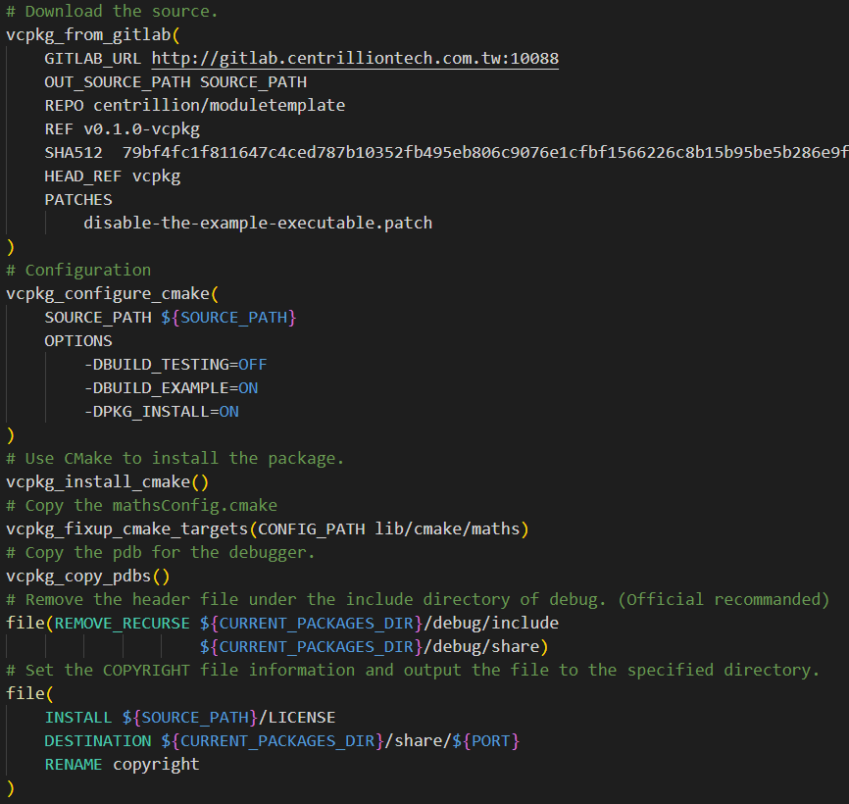
Manage Custom Libraries: Registries
portfile.cmake
Referred from the vcpkg.
Download
vcpkg_from_github
vcpkg_from_gitlab
vcpkg_from_git
Configuration and Build
vcpkg_configure_cmake
vcpkg_configure_make
Installation
vcpkg_install_cmake
vcpkg_install_make
Some fine adjustments
Copy the <port>Config.cmake.
Copy the pdb for the debugger.
Remove some useless header files.
Set the COPYRIGHT information.
Other actions.

Slide 50
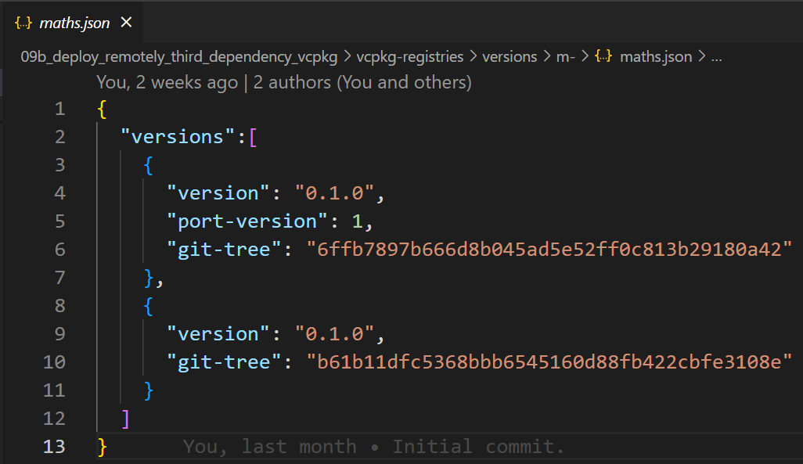
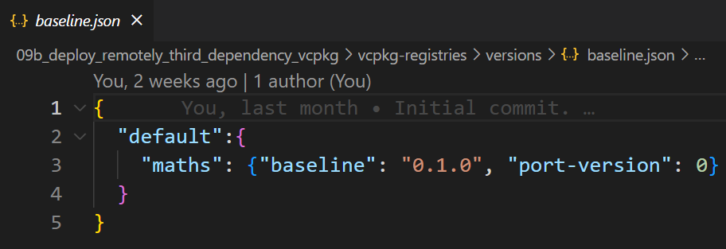
Manage Custom Libraries: Registries
<port>.json

Slide 51
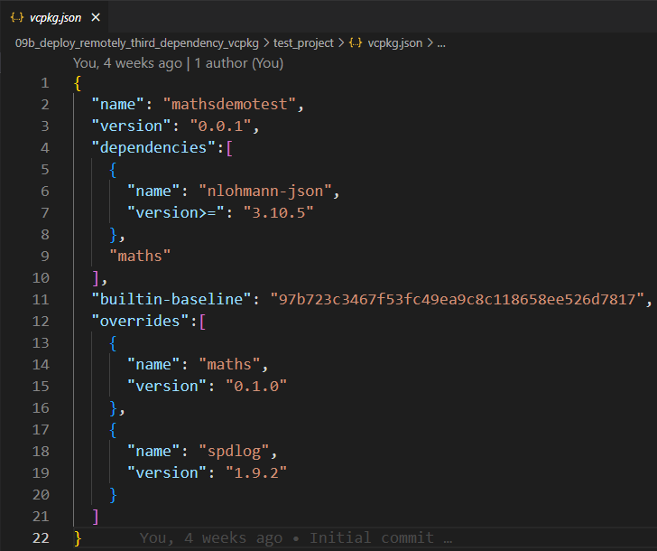
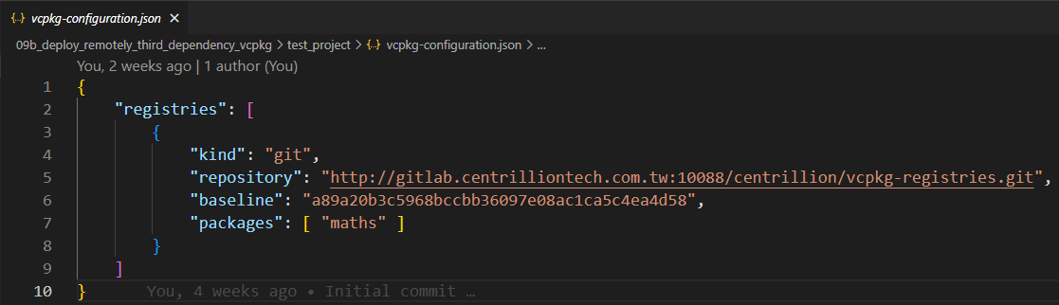
Manage Custom Libraries: Registries

Slide 52
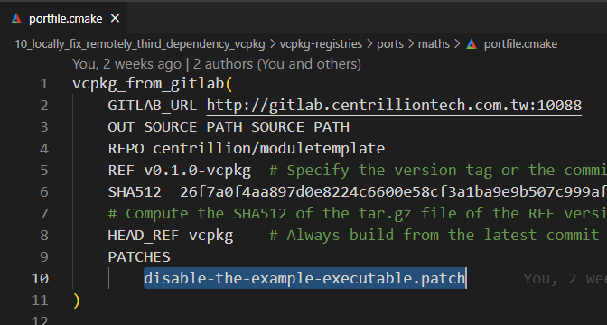
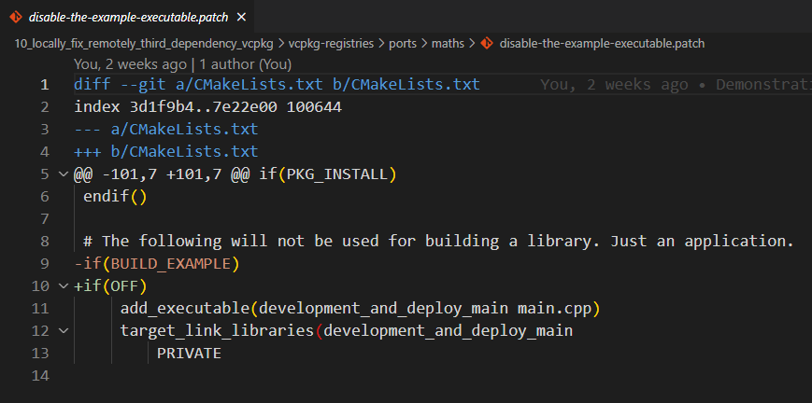
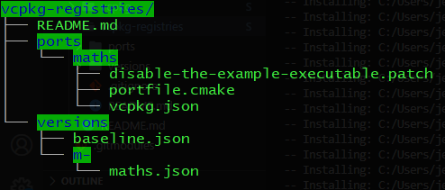
Build from Local Sources: Patching Mechanism
Specify the patch in the portfile.cmake.
Configure the downstream application with the DVCPKG_OVERLAY_PORTS CMake option.

Slide 53
Overall Workflow for the vcpkg Dependency Manager
In the vcpkg root directory , call git clean -dxf to remove all installed libraries and downloaded files.
Remove manually when cleaning cache files.
UNIX: $HOME/.cache/vcpkg

Slide 54


Demo

Slide 55
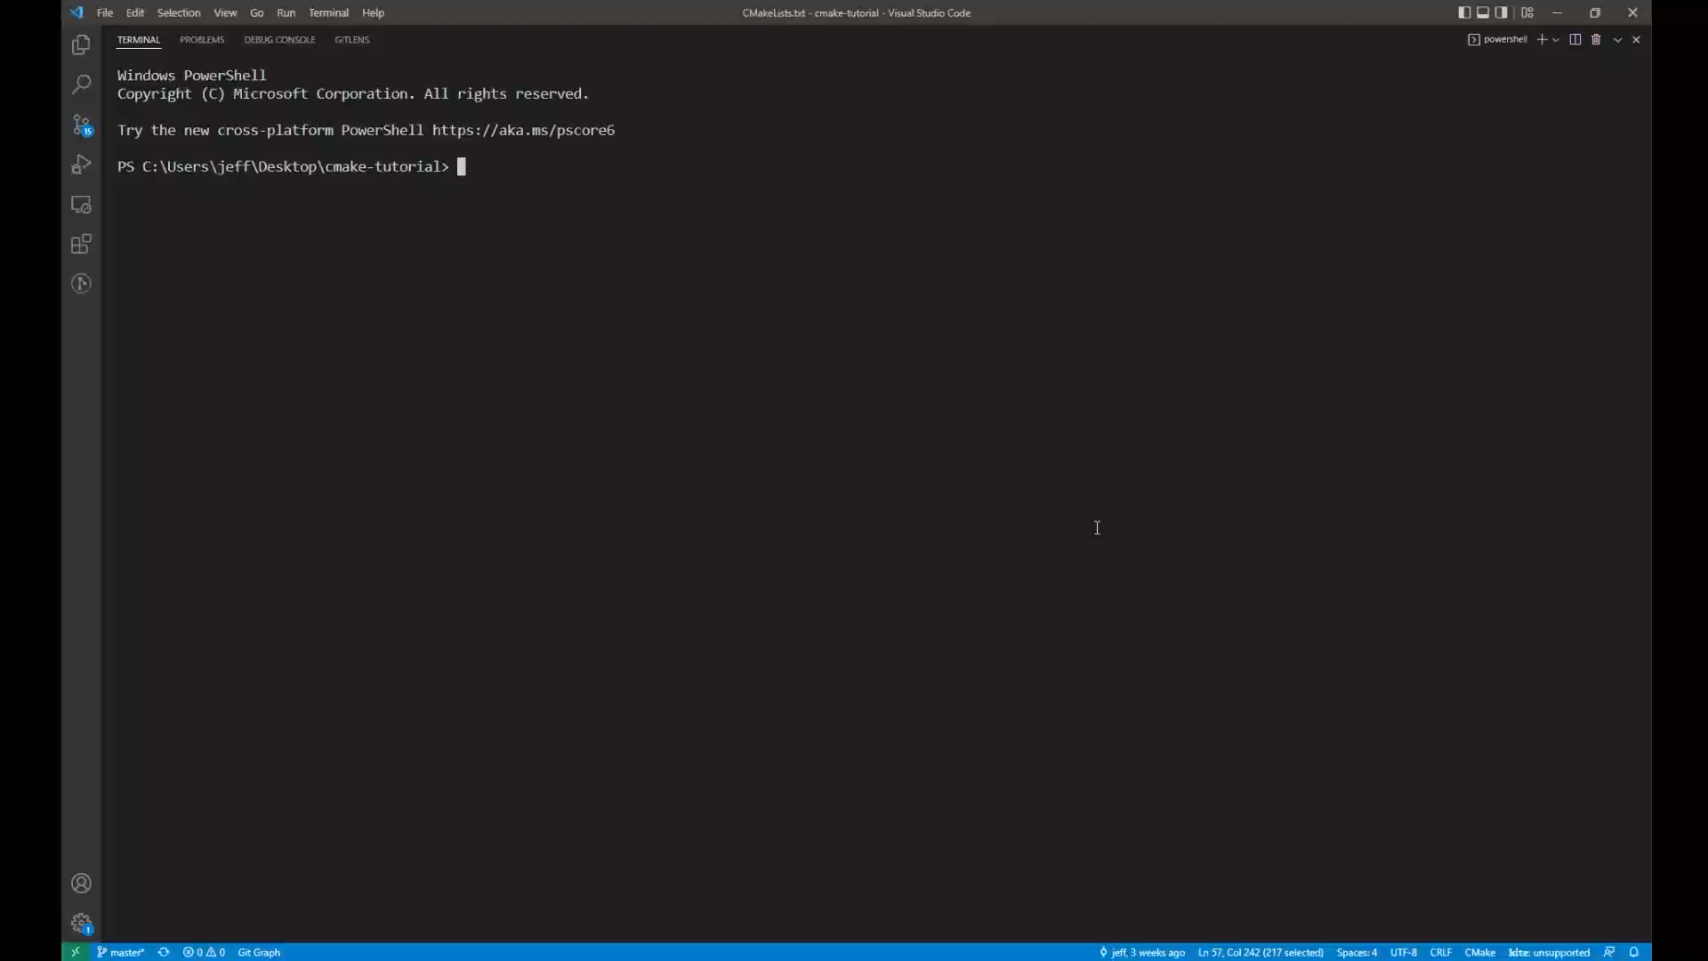
Manage Custom Libraries

Slide 56
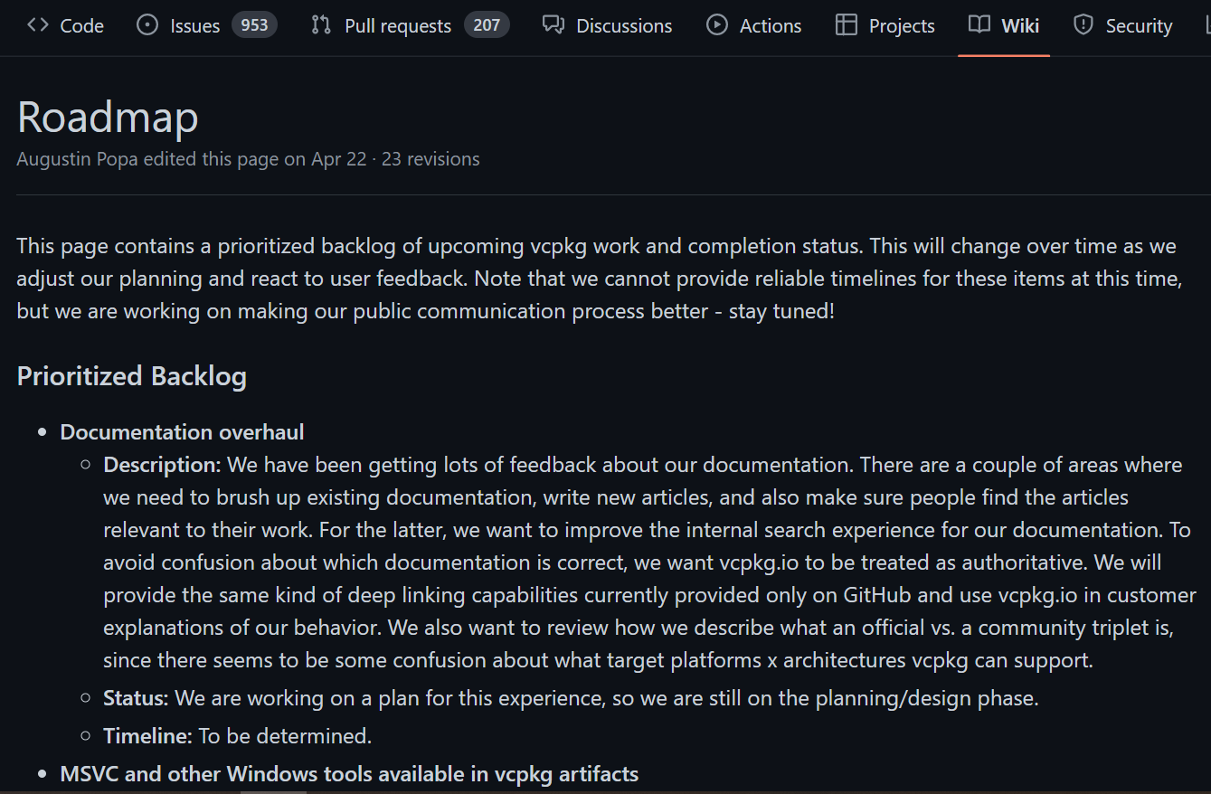
Learn More …
Binary Caching: vcpkg/binarycaching.md at dev/roschuma/binarycaching-spec · ras0219-msft/vcpkg (github.com)
vcpkg product roadmap: Roadmap · microsoft/vcpkg Wiki (github.com)
vcpkg dependencies versioning support information.

Slide 57
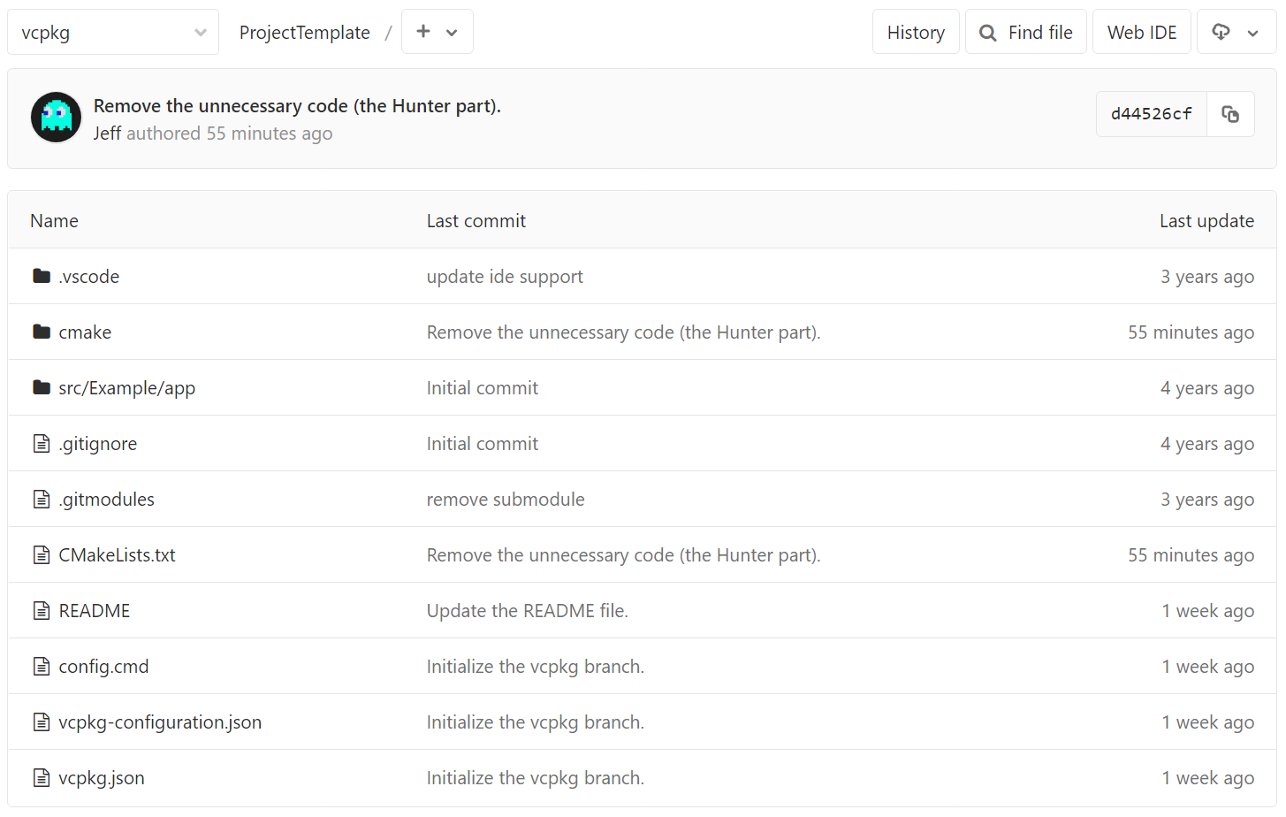
Learn More …
Module Template: centrillion / ModuleTemplate · GitLab (centrilliontech.com.tw)
Project Template: centrillion / ProjectTemplate · GitLab (centrilliontech.com.tw)

